Slide 1
Theorems of Boolean Algebra

Slide 2
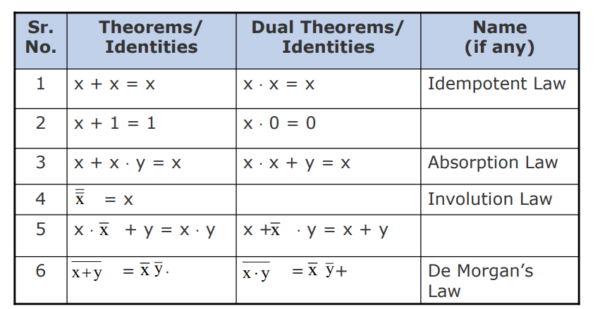

Slide 3
The theorems of Boolean algebra may be proved by using
one of the following methods:
By using postulates to show that L.H.S. = R.H.S
By Perfect Induction or Exhaustive Enumeration method where all possible combinations of variables involved in
L.H.S. and R.H.S. are checked to yield identical results
By the Principle of Duality where the dual of an already proved theorem is derived from the proof of its corresponding pair

Slide 4

Idempotent Law : - x+x=x or x.x=x
X+X=X
L.H.S
= X+X
=(x+x) . 1 by postulate x.1=x
=(x+x) .(x+$\overline{x}$) by postulate x+$\overline{x}$= 1
=x +(x.$\overline{x}$) by distributive law
=X+0 by postulate x.$\overline{x}$= 0
=x by postulate x+0 =x
=R.H.S

Slide 5

Idempotent Law
X.X=X
L.H.S
= X.X
=(x.x) + 0 by postulate x+0 =x
=(x.x) +(x.$\overline{x}$) by postulate x.$\overline{x}$= 0
=x .(x+$\overline{x}$) by distributive law
=x.1 by postulate x+$\overline{x}$= 1
=x by postulate x.1 =x
=R.H.S.

Slide 6
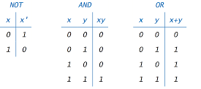

Slide 7
Proof by Perfect Induction or Exhaustive Enumeration
x+x=x
x | x | x+x
0 | 0 | 0
1 | 1 | 1
x.x=x
x | x | x.x
0 | 0 | 0
1 | 1 | 1

Slide 8

Theorem 2 : x+1=1 , x.0=0
X+1=1
L.H.S
=X+1
=(x+1).1 by postulate x.1=x
=(x+1). (x$+\overline{x}$) by postulate x+$\overline{x}$= 1
=x+(1.$\overline{x}$) by distributive law
=x+$\overline{x}$ by postulate x.1=x
=1 by postulate x+$\overline{x}$= 1
=R.H.S

Slide 9

Theorem 2
X.0=0
L.H.S
=X.0
=(x.0)+0 by postulate x+0=x
=(x.0)+ (x.$\overline{x}$) by postulate x.$\overline{x}$= 0
=x.(0+$\overline{x}$) by distributive law
=x.$\overline{x}$ by postulate x.1=x
=0 by postulate x.$\overline{x}$= 0
=R.H.S

Slide 11
Proof by Perfect Induction or Exhaustive Enumeration
X+1=1
x | Operand 2 | x+1
0 | 1 | 1
1 | 1 | 1
x.0=0
x | Operand 2 | x.x
0 | 0 | 0
1 | 0 | 0

Slide 12
Absoption Law
x+x.y=x
L.H.S
=x+x.y
=x.1+x.y by postulate x.1 =x
=x.(1+y) by distributive law
=x.1 by theorem x+1=1
=x by postulate x.1 =x
=R.H.S
.

Slide 13
Absoption Law
x.(x+y)=x
L.H.S
=x.(x+y )
=(x+0).(x+y) by postulate x+0 =x
=x+(0.y) by distributive law
=x+0 by theorm x.0=0
=x by postulate x+0 =x
=R.H.S

Slide 14
Proof by Perfect Induction or Exhaustive Enumeration
x+x.y=x
x | y | x.y | x+x.y
0 | 0 | 0 | 0
0 | 1 | 0 | 0
1 | 0 | 0 | 1
1 | 1 | 1 | 1
x.(x+y)=x
x | y | x+y | x.(x+y)
0 | 0 | 0 | 0
0 | 1 | 1 | 0
1 | 0 | 1 | 1
1 | 1 | 1 | 1

Slide 15
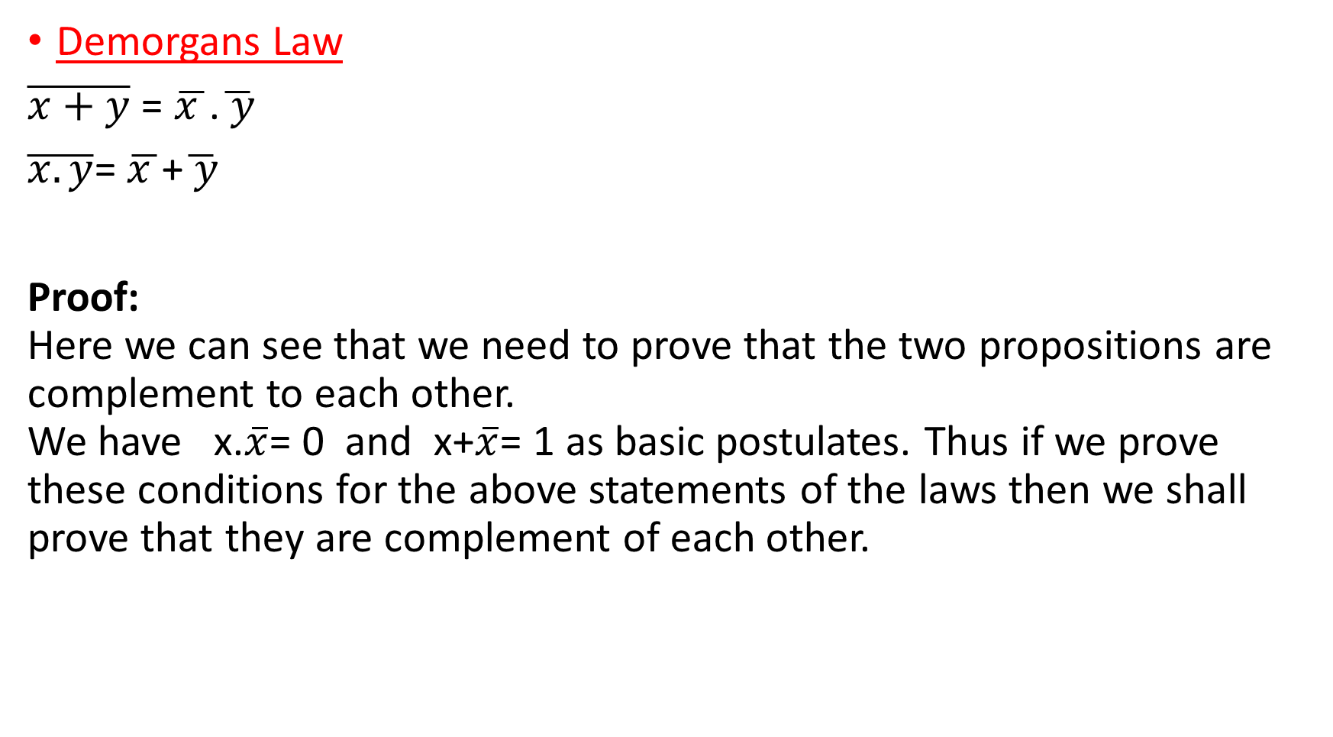
Demorgans Law
$\overline{x+y}$ = $\overline{x }$.$\overline{ y}$
$\overline{x.y}$= $\overline{x }$+$\overline{ y}$
Proof: Here we can see that we need to prove that the two propositions are complement to each other. We have x.$\overline{x}$= 0 and x+$\overline{x}$= 1 as basic postulates. Thus if we prove these conditions for the above statements of the laws then we shall prove that they are complement of each other.

Slide 16

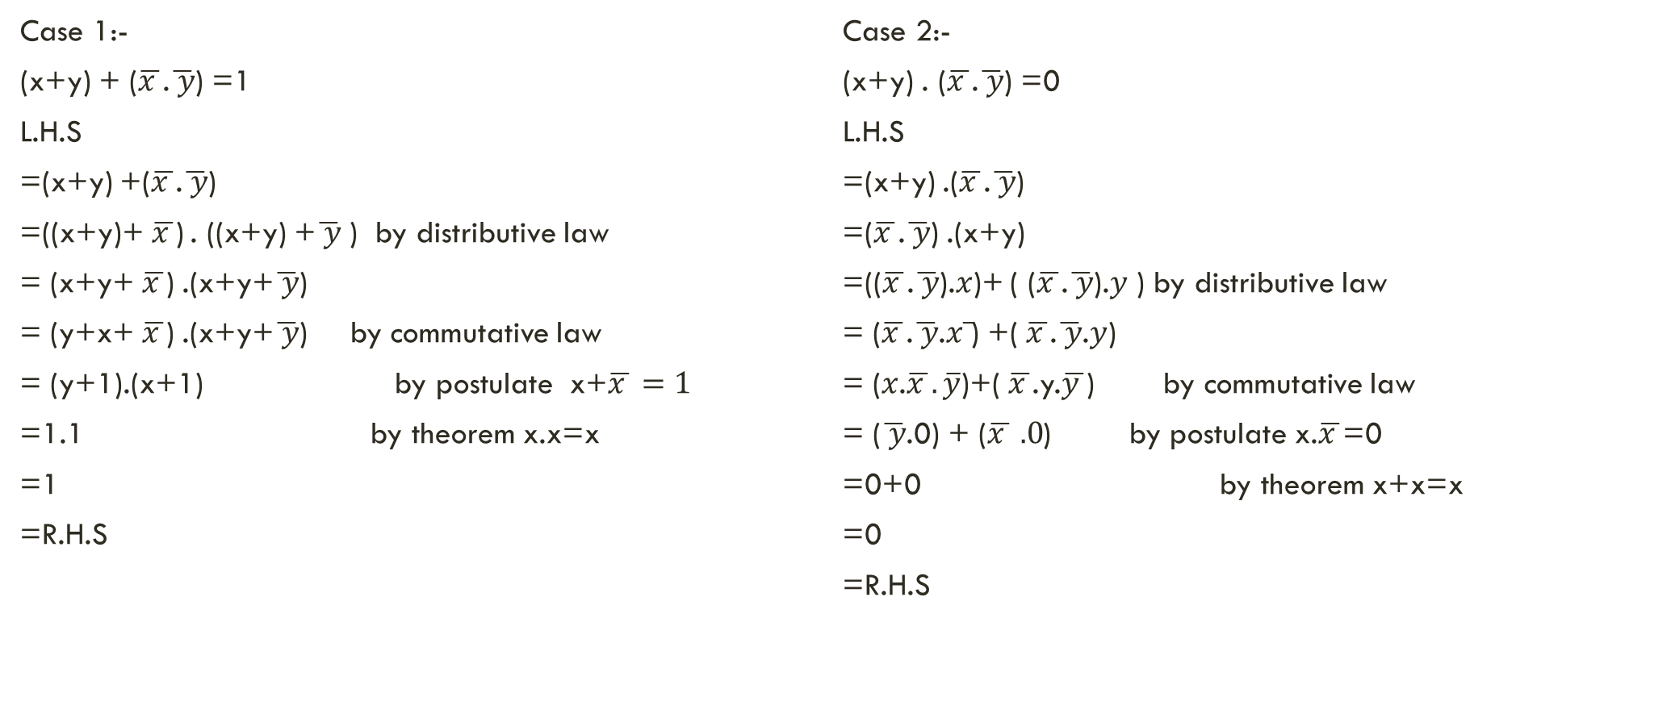
To prove $\overline{x+y}$ = $\overline{x }$.$\overline{ y}$
Case 1:-
(x+y) + ($\overline{x }$.$\overline{ y}$) =1
L.H.S
=(x+y) +($\overline{x }$.$\overline{ y}$)
=((x+y)+$\overline{x }$) . ((x+y) +$\overline{ y}$ ) by distributive law
= (x+y+$\overline{x }$) .(x+y+$\overline{ y}$)
= (y+x+$\overline{x }$) .(x+y+$\overline{ y}$) by commutative law
= (y+1).(x+1) by postulate x+$\overline{x }=1$
=1.1 by theorem x.x=x
=1
=R.H.S
Case 2:-
(x+y) . ($\overline{x }$.$\overline{ y}$) =0
L.H.S
=(x+y) .($\overline{x }$.$\overline{ y}$)
=($\overline{x }$.$\overline{ y}$) .(x+y)
=(($\overline{x }$.$\overline{ y}$).$x$)+ ( ($\overline{x }$.$\overline{ y}$).$y$ ) by distributive law
= ($\overline{x }$.$\overline{ y}$.$x\overline{ }$) +($\overline{x }$.$\overline{ y}$.$y$)
= ($x$.$\overline{x }. \overline{y}$)+($\overline{x }$.y.$\overline{y }$) by commutative law
= ($\overline{ y}$.0) + ($\overline{x } .0$) by postulate x.$\overline{x }$=0
=0+0 by theorem x+x=x
=0
=R.H.S

Slide 17
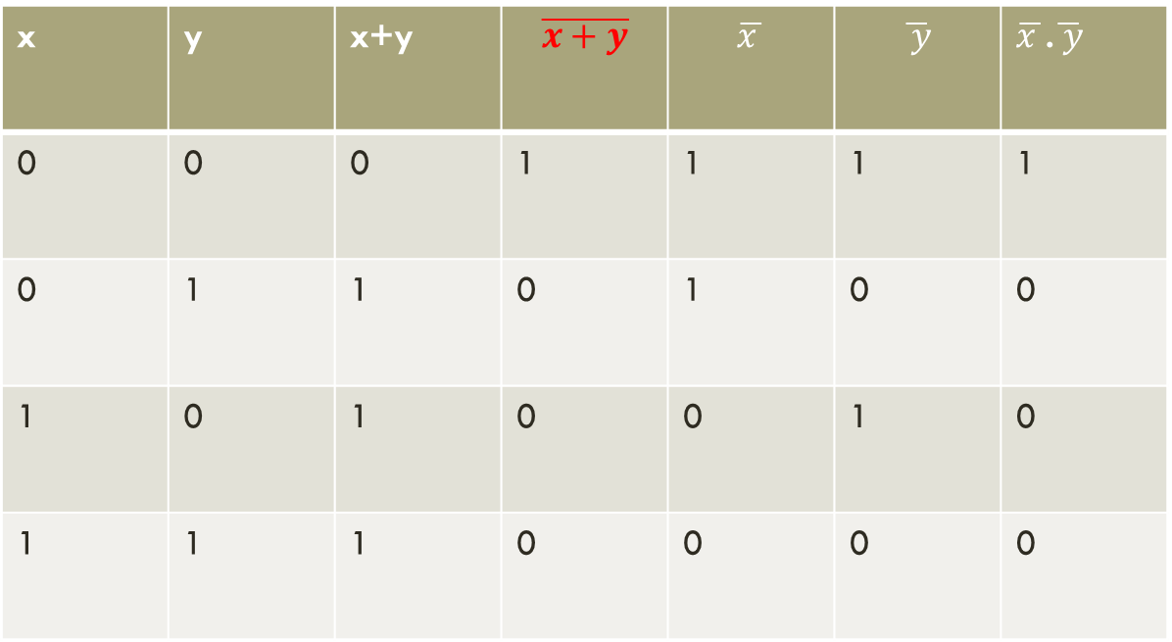
x | y | x+y | $$\overline{x+y}$$ | $$\overline{x }$$ | $$\overline{ y}$$ | $\overline{x }$.$\overline{ y}$
0 | 0 | 0 | 1 | 1 | 1 | 1
0 | 1 | 1 | 0 | 1 | 0 | 0
1 | 0 | 1 | 0 | 0 | 1 | 0
1 | 1 | 1 | 0 | 0 | 0 | 0

Slide 18
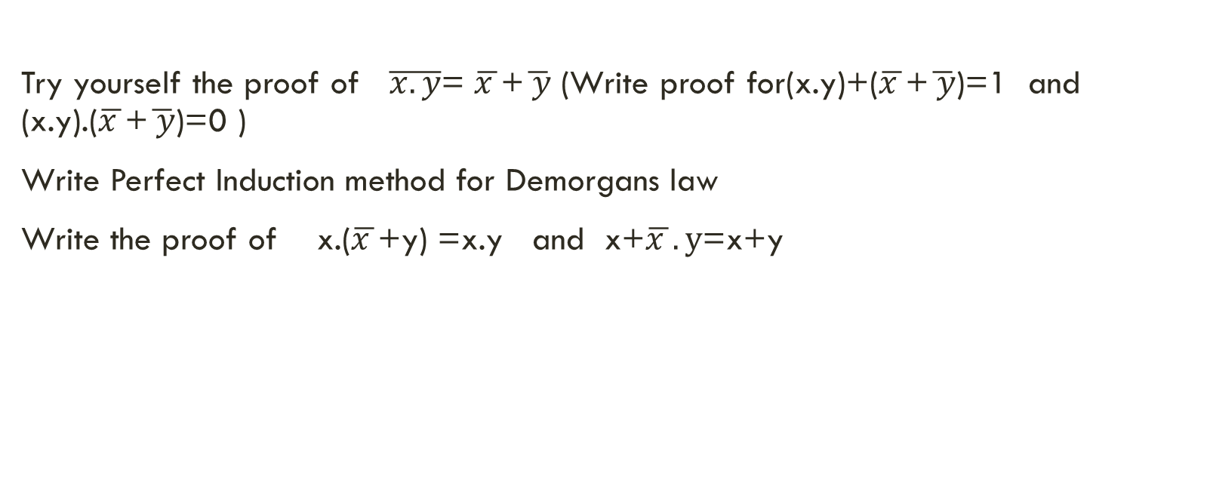
Try yourself the proof of $\overline{x.y}$= $\overline{x }$+$\overline{ y}$ (Write proof for(x.y)+($\overline{x }$+$\overline{ y}$)=1 and (x.y).($\overline{x }$+$\overline{ y}$)=0 )
Write Perfect Induction method for Demorgans law
Write the proof of x.($\overline{x }$+y) =x.y and x+$\overline{x }.y$=x+y

Slide 19

Involution law
$\overline{\overline{x}}$=x
we have x.$\overline{x}$= 0 and x+$\overline{x}$=1 as basic postulate, ,hence we can say x is the complement of $\overline{x }$.

Slide 20
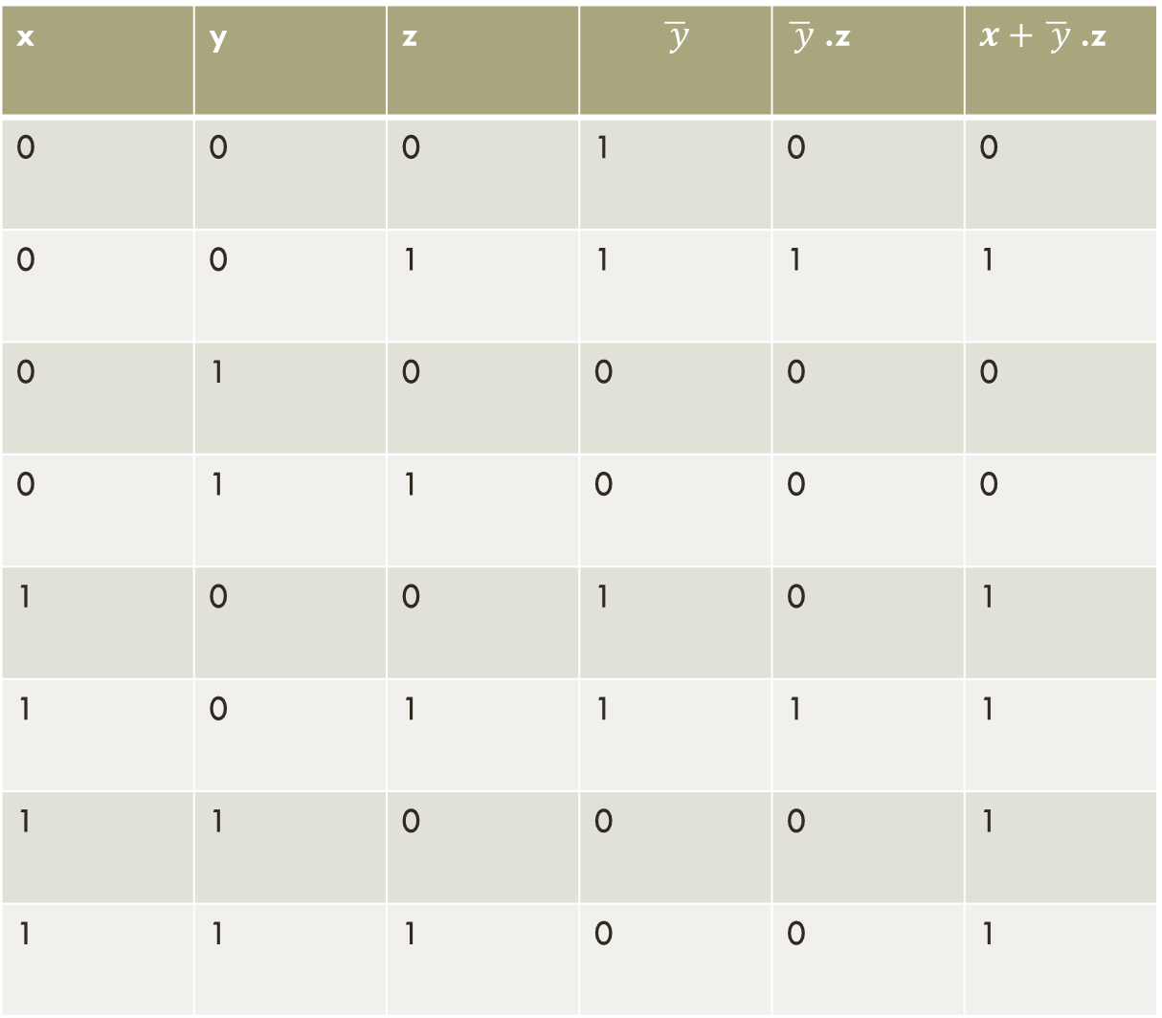
x | y | z | $$\overline{ y}$$ | $\overline{ y}$ .z | $x+\overline{ y}$ .z
0 | 0 | 0 | 1 | 0 | 0
0 | 0 | 1 | 1 | 1 | 1
0 | 1 | 0 | 0 | 0 | 0
0 | 1 | 1 | 0 | 0 | 0
1 | 0 | 0 | 1 | 0 | 1
1 | 0 | 1 | 1 | 1 | 1
1 | 1 | 0 | 0 | 0 | 1
1 | 1 | 1 | 0 | 0 | 1

